Slide 1
Domain Case Study: BFSI

Slide 2
Problem Statement
Credit risk refers to the possibility that payments may be made late or not at all, which may result in cash flow issues and may impact a bank’s liquidity. Despite advancements in the financial services industry, credit risk continues to be the key factor in bank failures. In most cases, this part of risk management accounts for more than 70% of a bank’s balance sheet. Therefore, it is imperative for any financial institution to determine customers’ credit scores and SmartLend , a financial institution wants to work on it.
Goal :
SmartLend would like to better understand the primary factors that contribute to a person's credit score based on their demographics and past transactions data.
Using historical information, it wants to be able to predict which credit bucket a customer would fall into. They have defined 3 buckets, Good , Poor and Standard.
SmartLend wants to use this information to make lending decisions more robust and accurate thereby decreasing their credit risk.

Slide 3
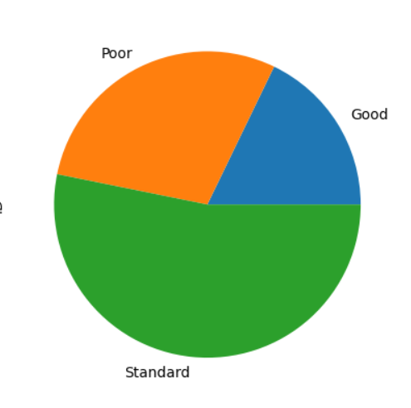
Data Understanding
SmartLend has shared 8 months of analysis and model building. It has 28 columns including Credit Score.
Credit Score is having 3 classes ; Poor, Good and Standard.
This data belongs information like customer details , outstanding debts , interest rates, loan type etc. As some of the columns like Customer ID , SSN are identifiers we cannot use them to build the model
Also they have provided a separate test data set to predict the credit score based for each customer based on selected model.
Data is highly imbalanced.

Slide 4
Data Assumptions and Preparation
Type of loan column is having multiple types of loan and in some cases multiple loans are take. So based on all different loans available we have created a separate column for each of the loan type. Following new columns are created for the same :
Personal Loan
Credit Builder Loan
Auto Loan
Payday Loan
Debt Consolidation Loan
Home Equity Loan
Mortage Loan

Slide 5
Data Assumptions and Preparation
Payment_of_Min_Amount : NM is replaced with No.
Payment_Behaviour , Credit Mix , Occupation : Garbage value is replaced with Unknown
Numeric columns having null values filled with 0 considering that its not applicable.
Outliers are treated with the help of finding interquartile range, lower and upper bounds.
During data cleaning , we have tried to keep the data distribution intact.
Test data file is also cleaned for only null values. Outliers are kept as it just not manipulate/reduce the actual test data much.

Slide 6
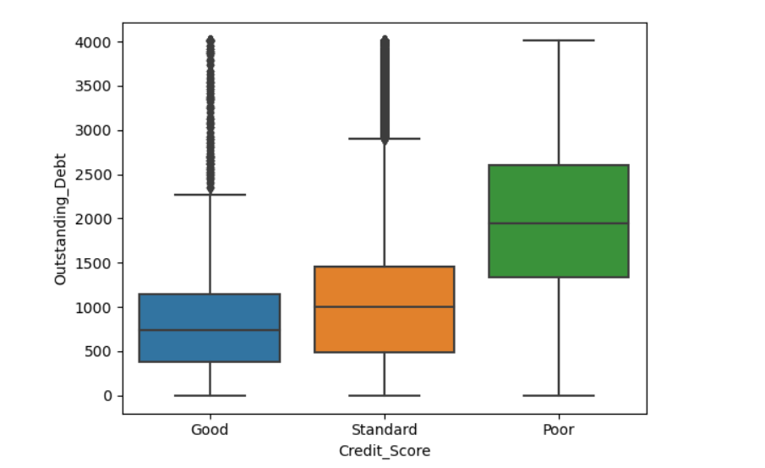
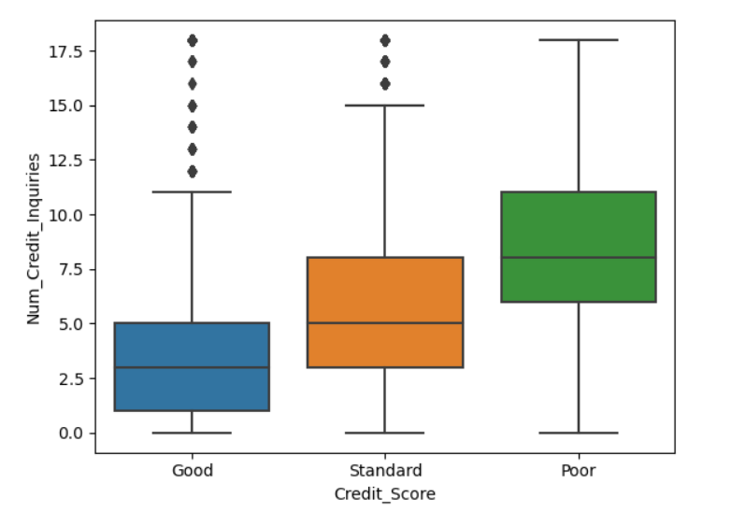
Data Analysis and Insights
Outstanding Debt
Number of Credit Enquiries

Slide 7
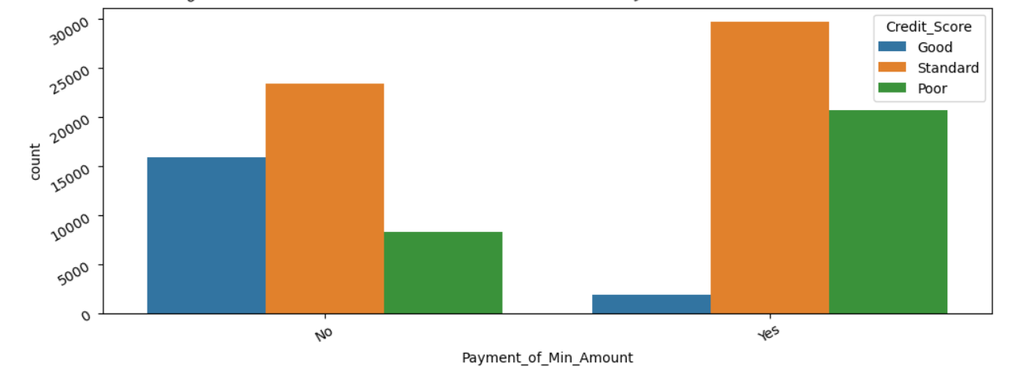
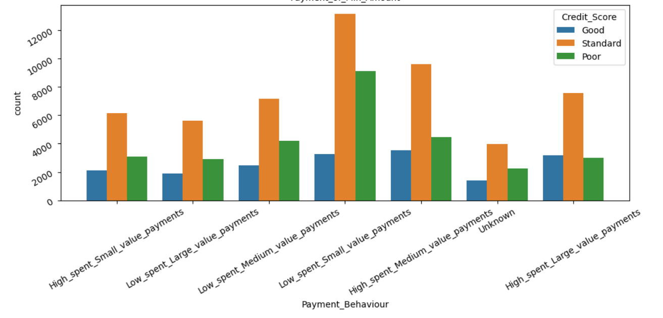
Data Analysis and Insights
Payment of Min Amount
Payment Behavior
Delay from Due Date

Slide 8
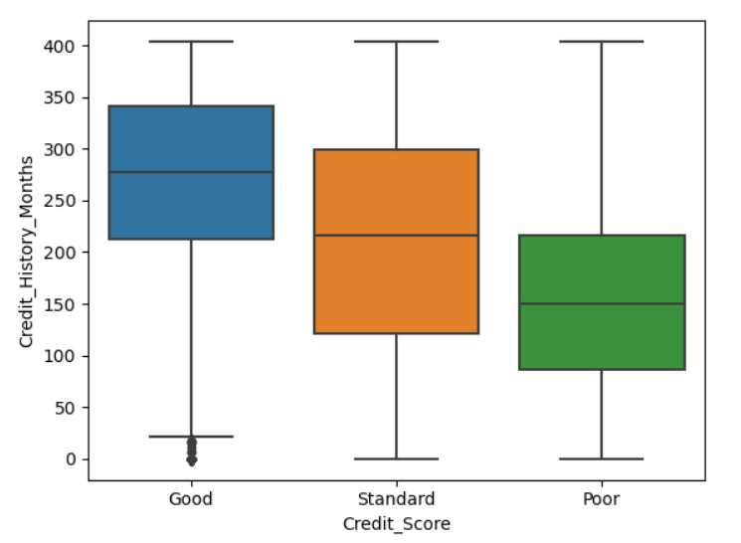
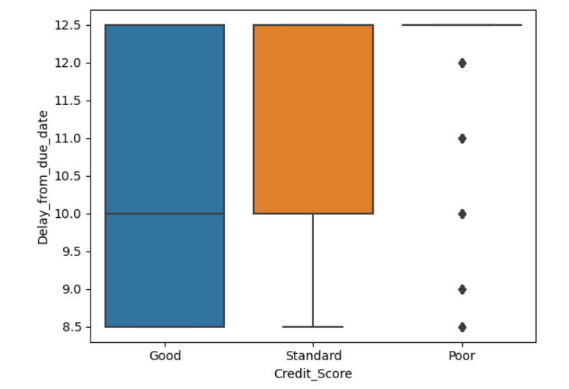
Data Analysis and Insights
Credit History Months
Delay from Due Date

Slide 9
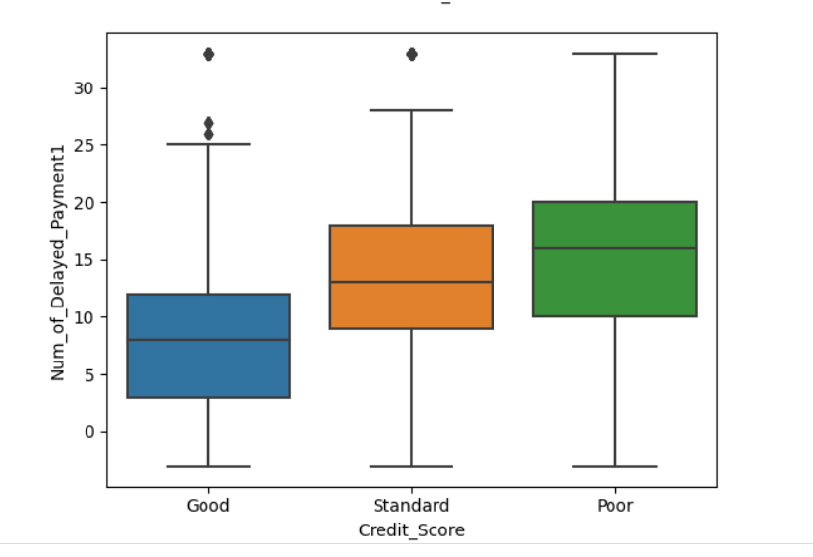
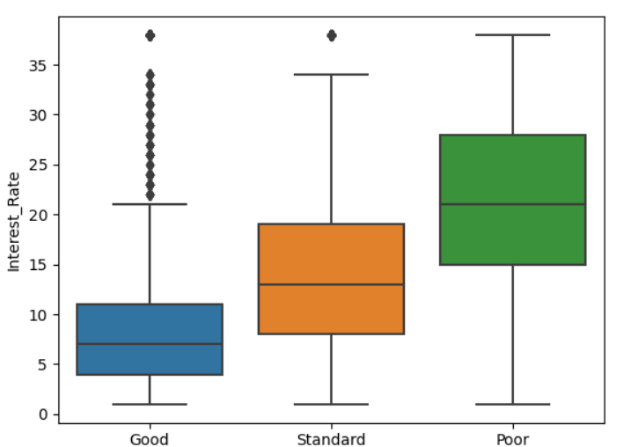
Data Analysis and Insights
Number of Payments Delayed
Number of Credit Enquiries

Slide 10
Model building
Classification : Multi-classifier
Models tried : Decision Tree and Random Forest
Data is highly unbalanced hence tried following approaches:
Assigning class weight during model initiation based on number of scores for each class.
Resampled the data with undersampling algorithm TOMEKLinks
Resampled the data with oversampling algorithm SMOTE.
Model is evaluated based on Recall , Precision , Accuracy with normal and weighted average as well. Also , Confusion Matrix is also validated for all the models.
Grid Search is used for hypertuning the models.

Slide 11
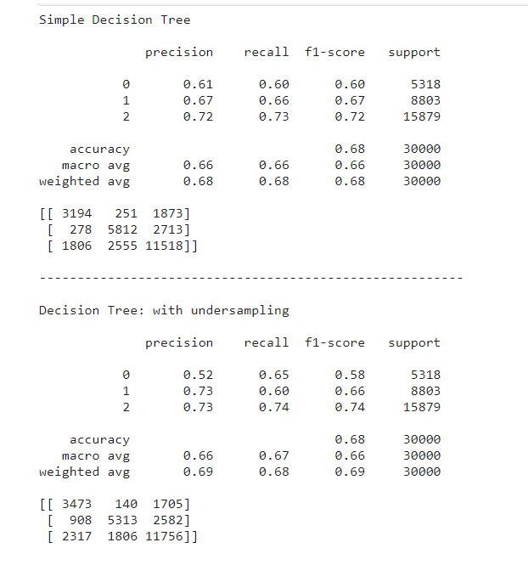
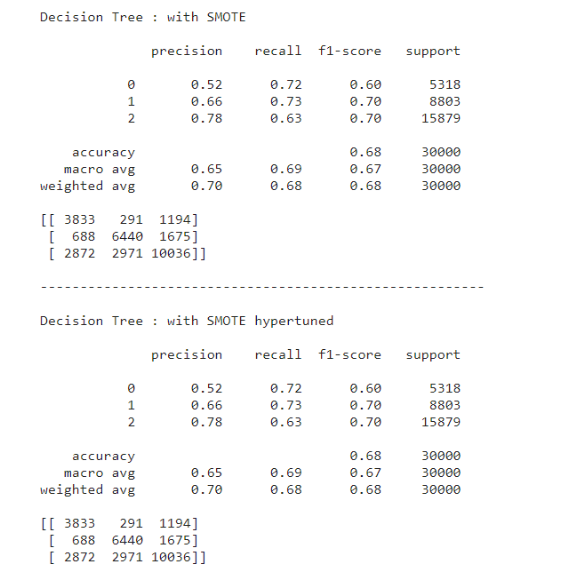
Model Scores– Decision Tree

Slide 12
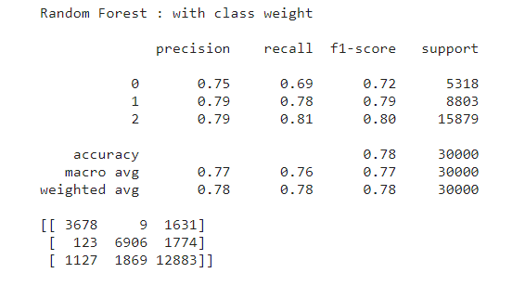
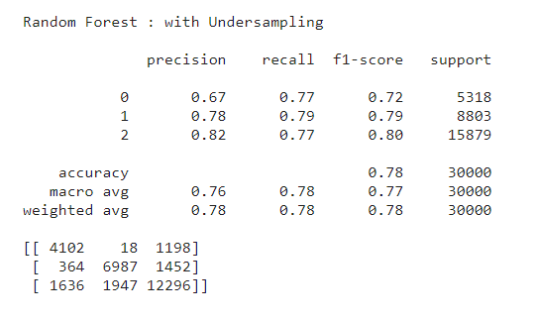
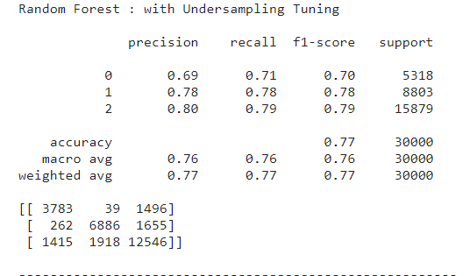
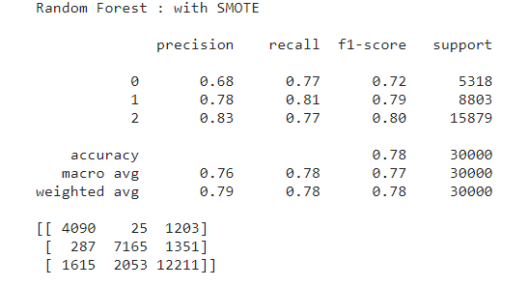
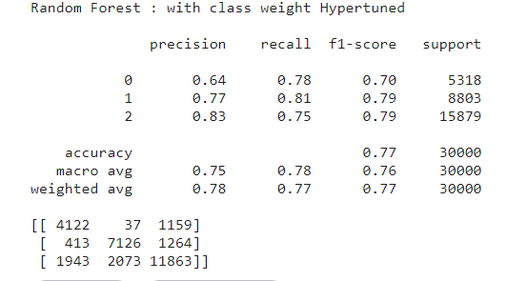
Model Scores– Random Forest
We selected Random Forest with TOMEKLink for now considering all the scores, resampling techniques advantage and disadvantages.

Slide 13
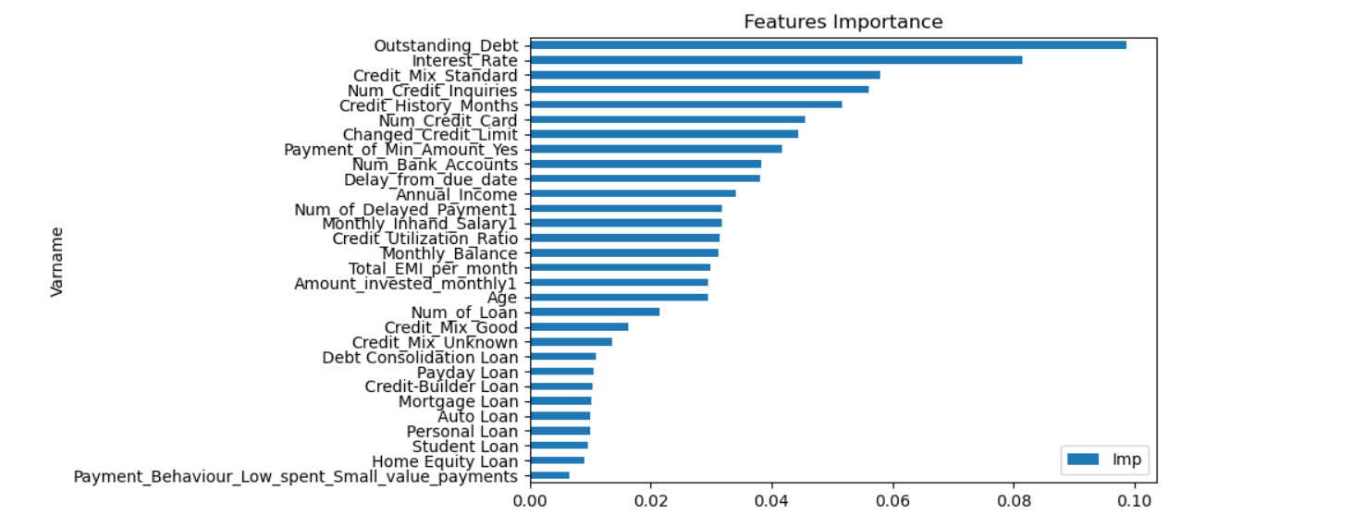
Important Features

Slide 14
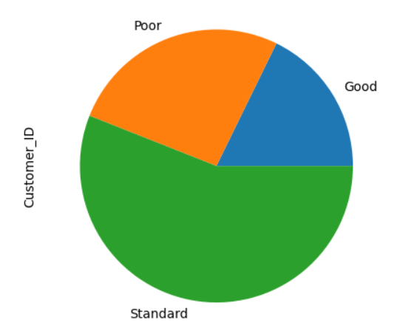
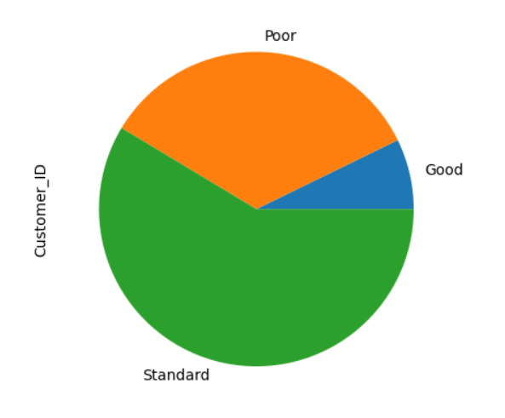
Conclusion
Train Set
Highest outstanding debt, highest interest rates , high credit enquiries , high number of credit cards or bank accounts holding are key factors to identify customers who might miss/delay their loan payment. These customers should be scrutinized more.
Min payment amount opted loans are high risk loans and customers who have this option should also be enquired in detail before disbursing the loan.
The more the customer delays the payment the more there is a risk and hence such customers should be called regularly for payment reminders.
Old customers having more credit history data are either good or standard customers and they should be retained.
Customer’s monthly and annual income conditions should be more strict to avoid risks.
Validation Set

